Slide 1

Diagnostic Assessment and Instructional Tool
Welcome to…

Slide 2

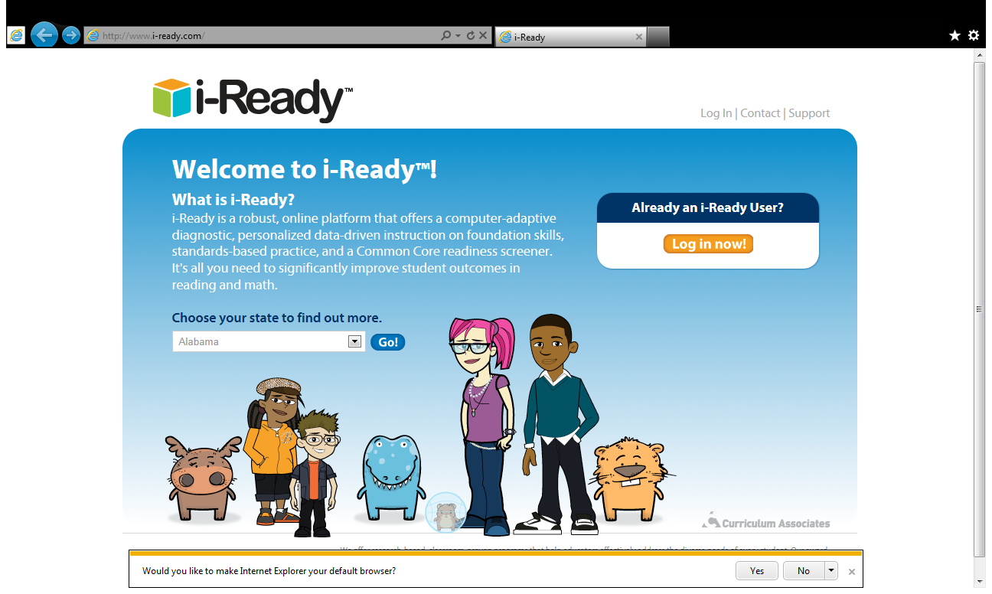
Click on the Log in Now button!

Slide 3
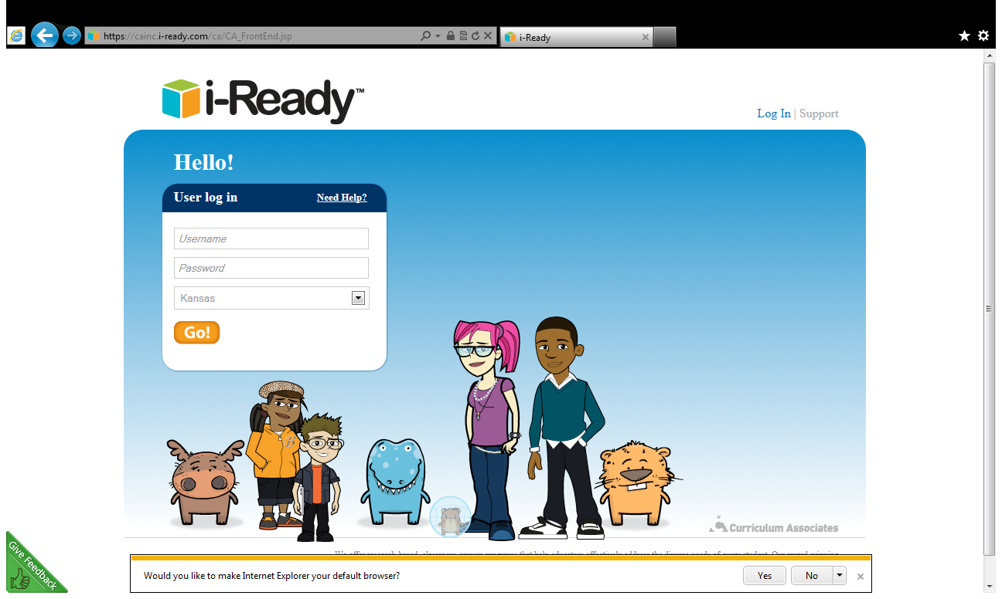
Make sure you click Kansas!

Slide 4
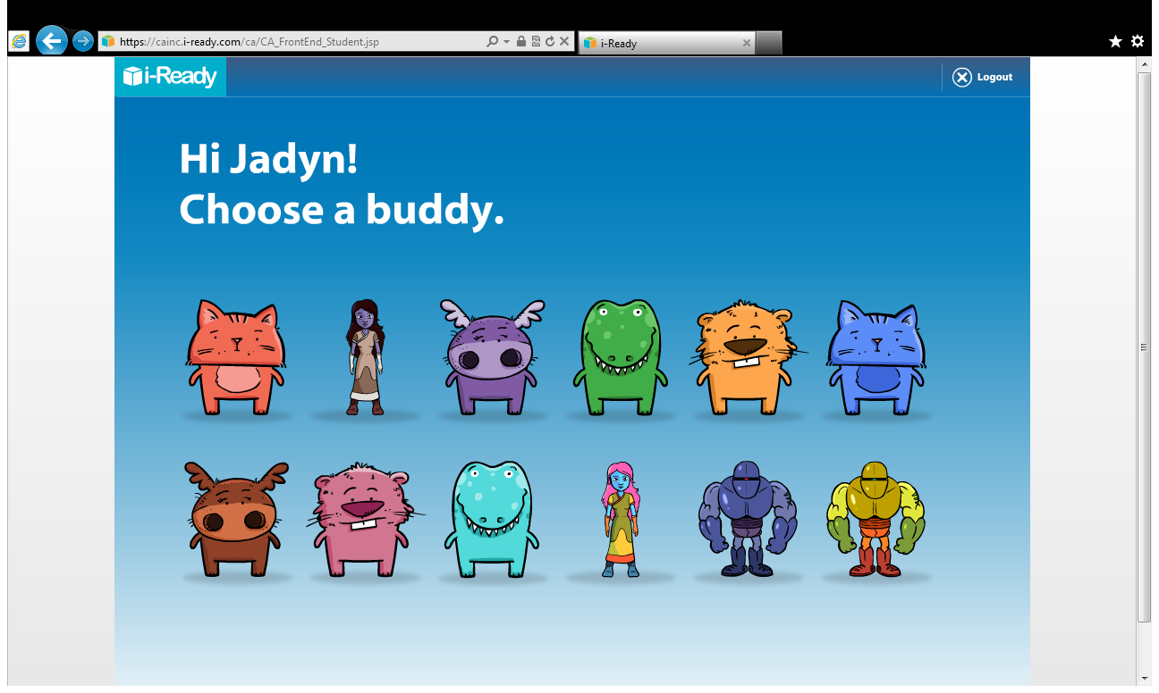
When your child logs in, they will be prompted to choose a “study buddy”.

Slide 5
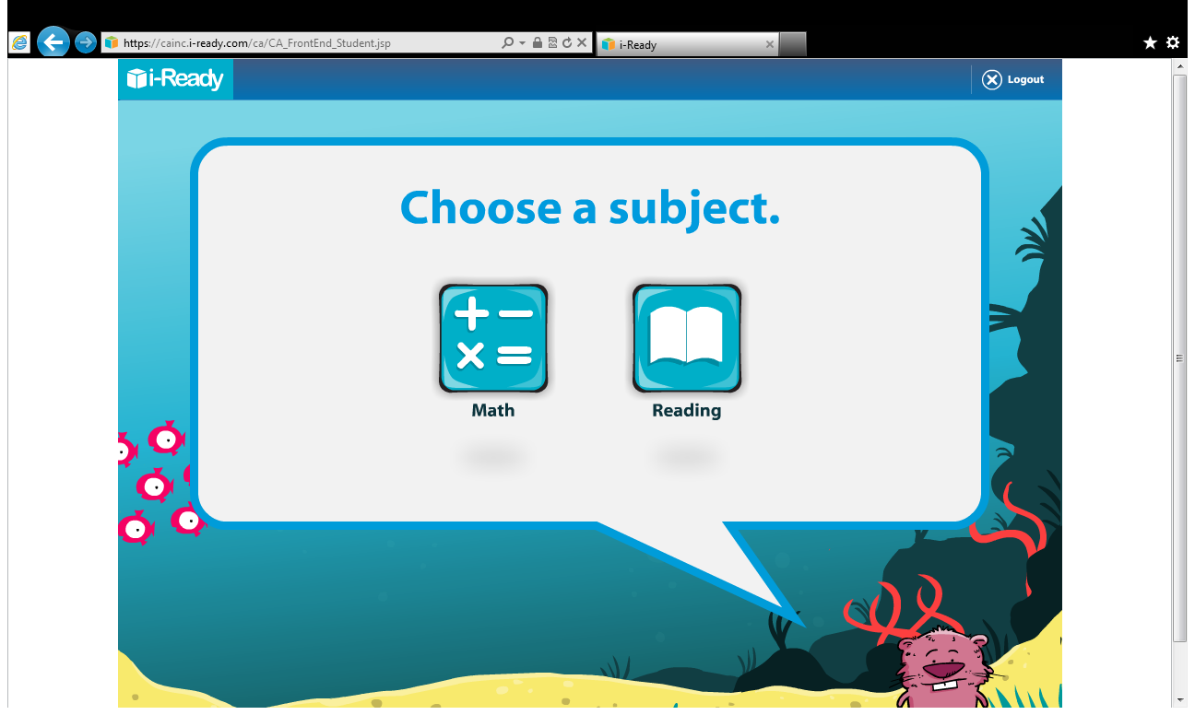
You may have one or both subjects show up. We will start with Reading.

Slide 6
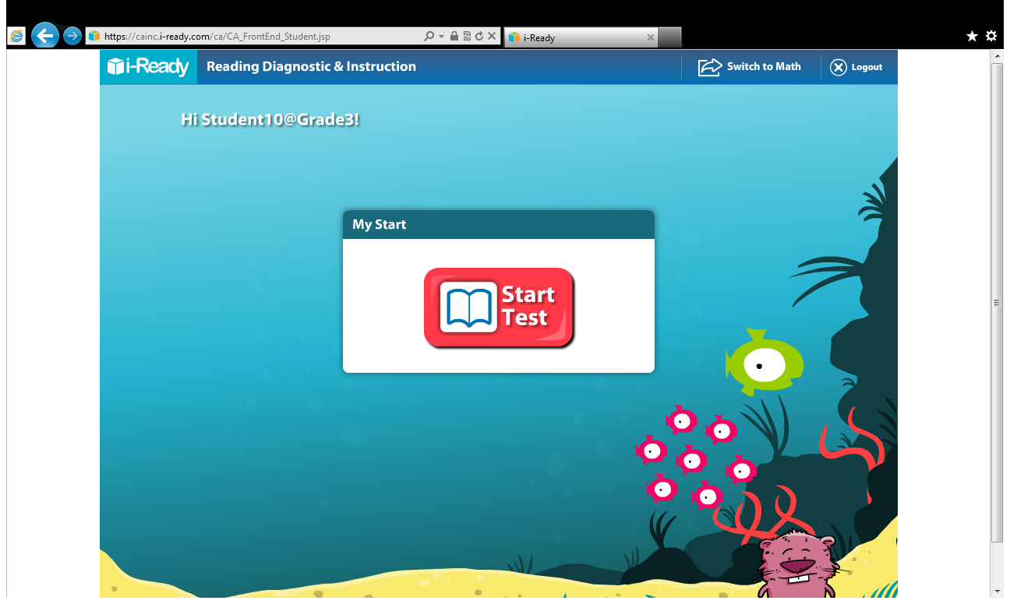
Before working in the instructional portion of the i-Ready, your student will
take a diagnostic assessment in order to place them in the correct instructional level.
The assessment will
take approximately
45 minutes.

Slide 7
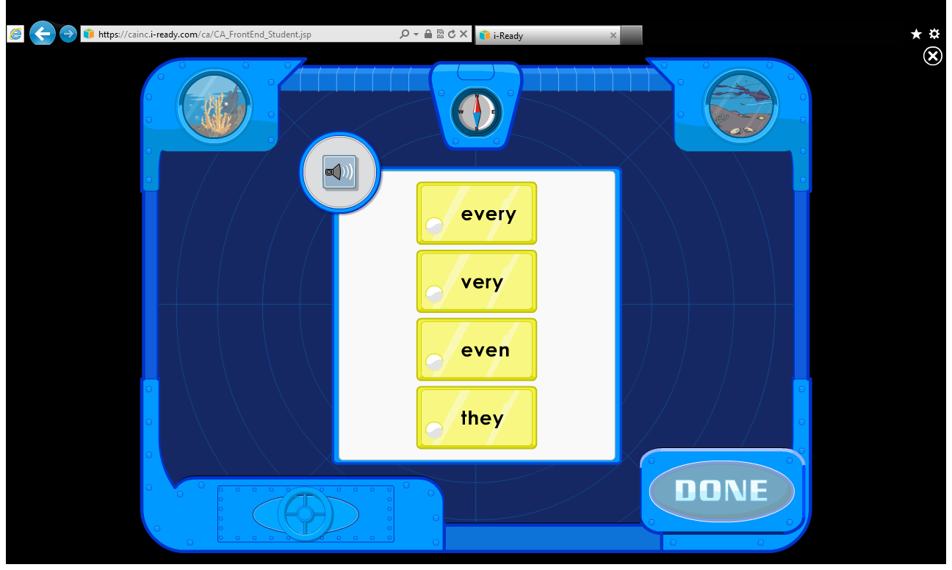
Your child can stop at any time during the assessment. Next time they log in,
i-Ready will take them to the place where they left off.

Slide 8
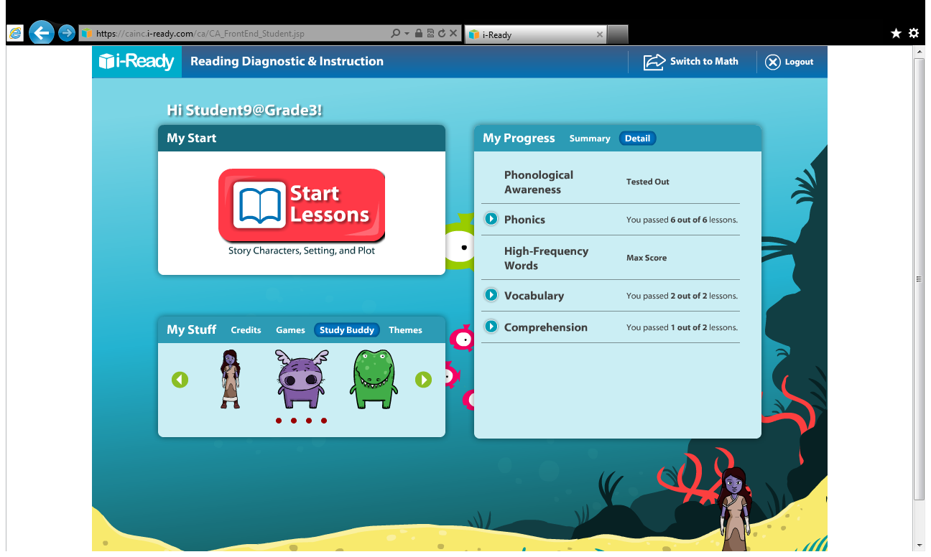
Once the assessment is complete, your child will have access to instructional
lessons in the areas of : Phonological Awareness, Phonics, Sight words, Vocabulary
and Comprehension.

Slide 9
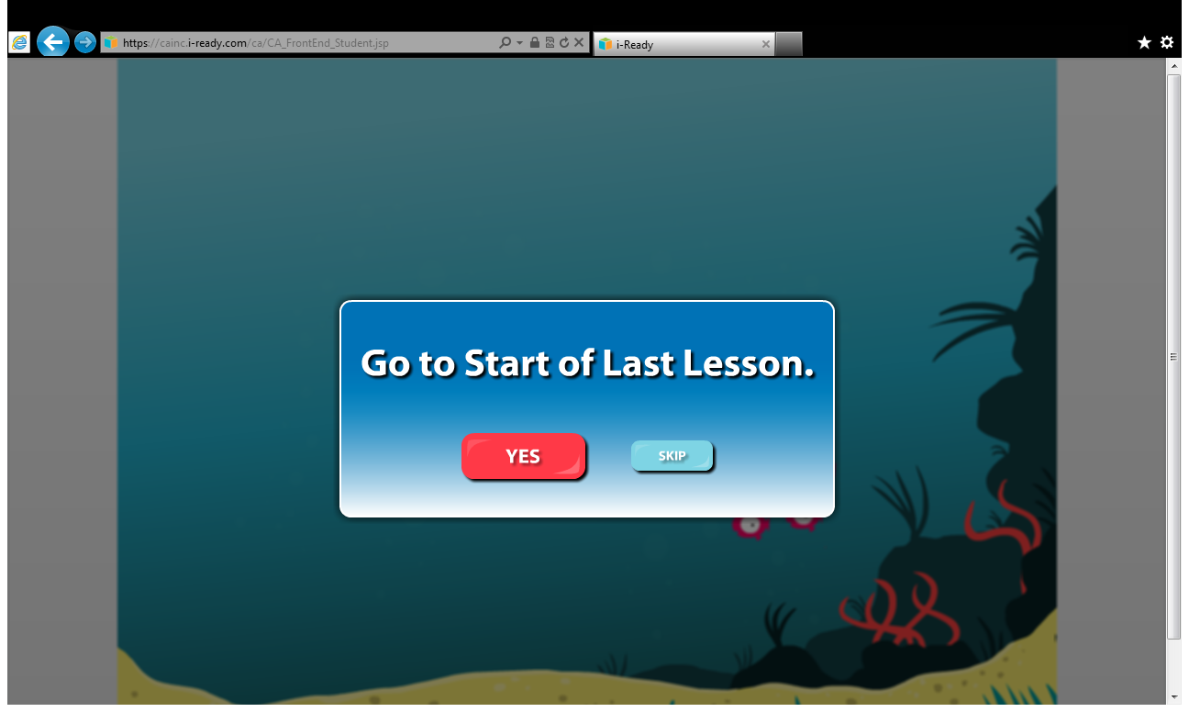

Slide 10
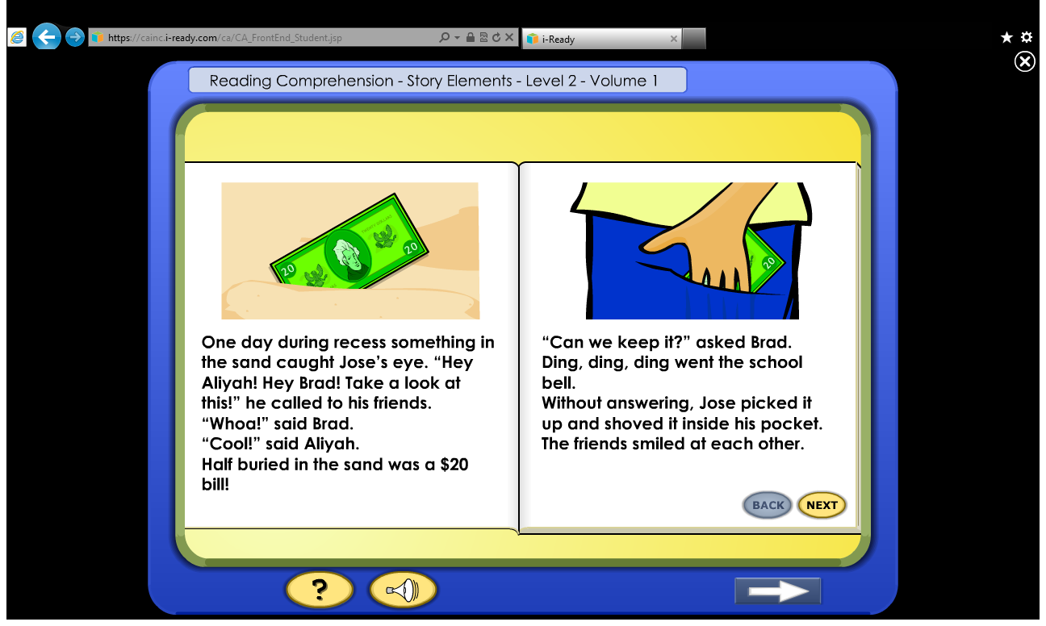
Click on the speaker below if your child wants the story read to them.
Click on this button to have
the story read to you.

Slide 11

Whenever your child is ready to quit, just click on the x. The next time they log in
the lesson will take them to where they left off.

Slide 12
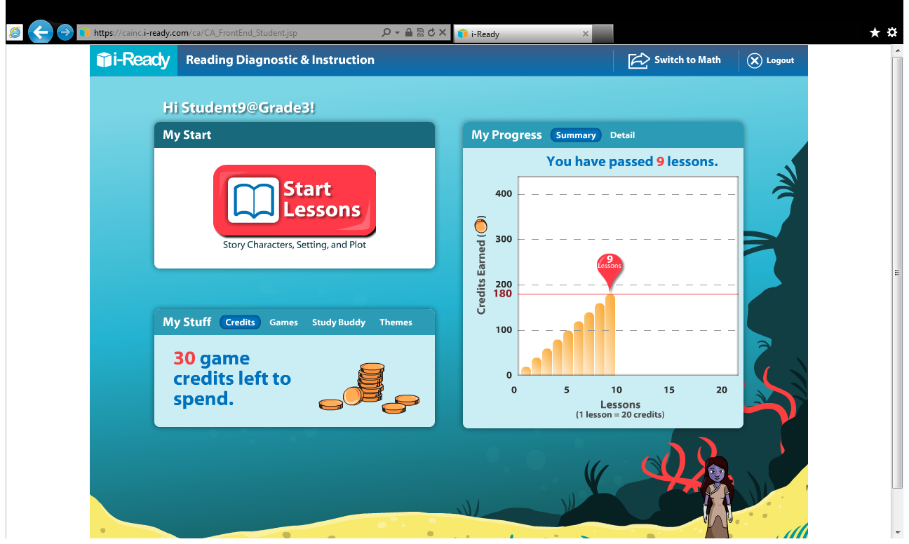
The Learning Coach will have access to their student’s progress summary and details.

Slide 13
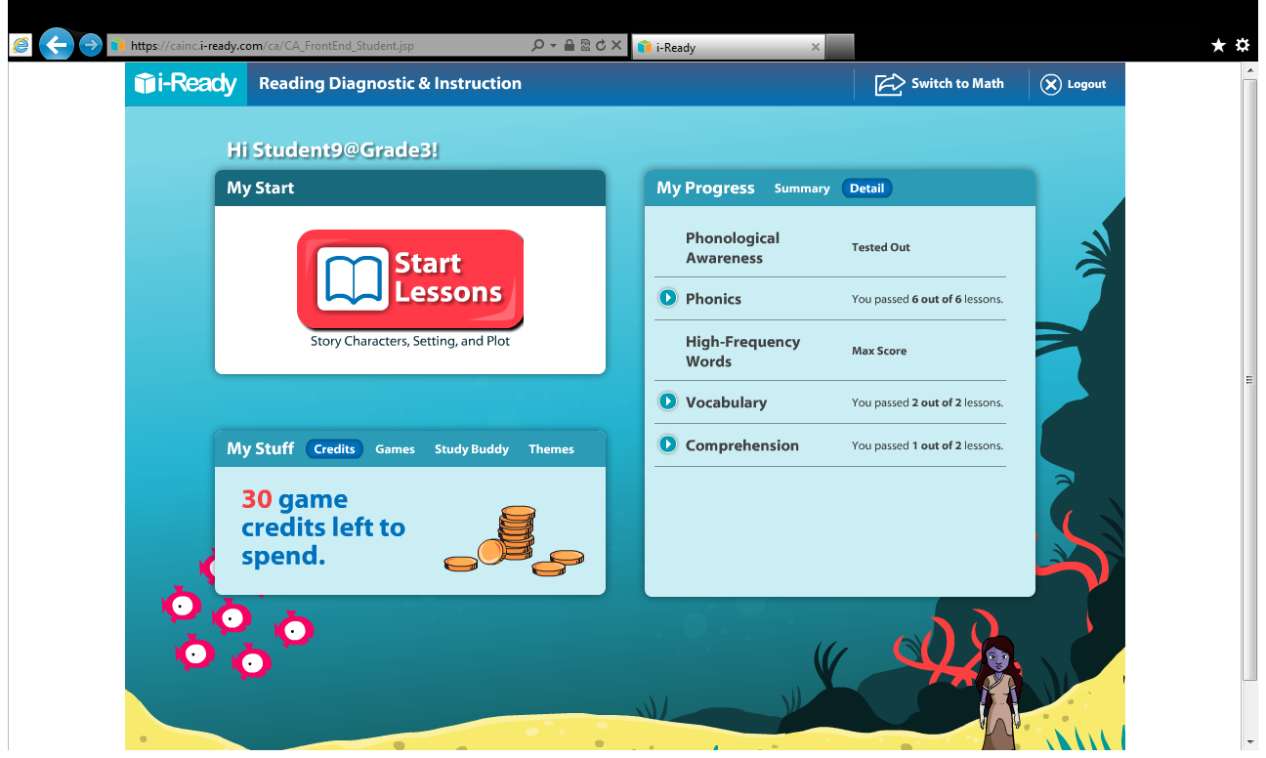
Students will have access to the credits they earn during their lessons . Students earn
credits when they earn a 70% or higher on skill assessments.

Slide 14
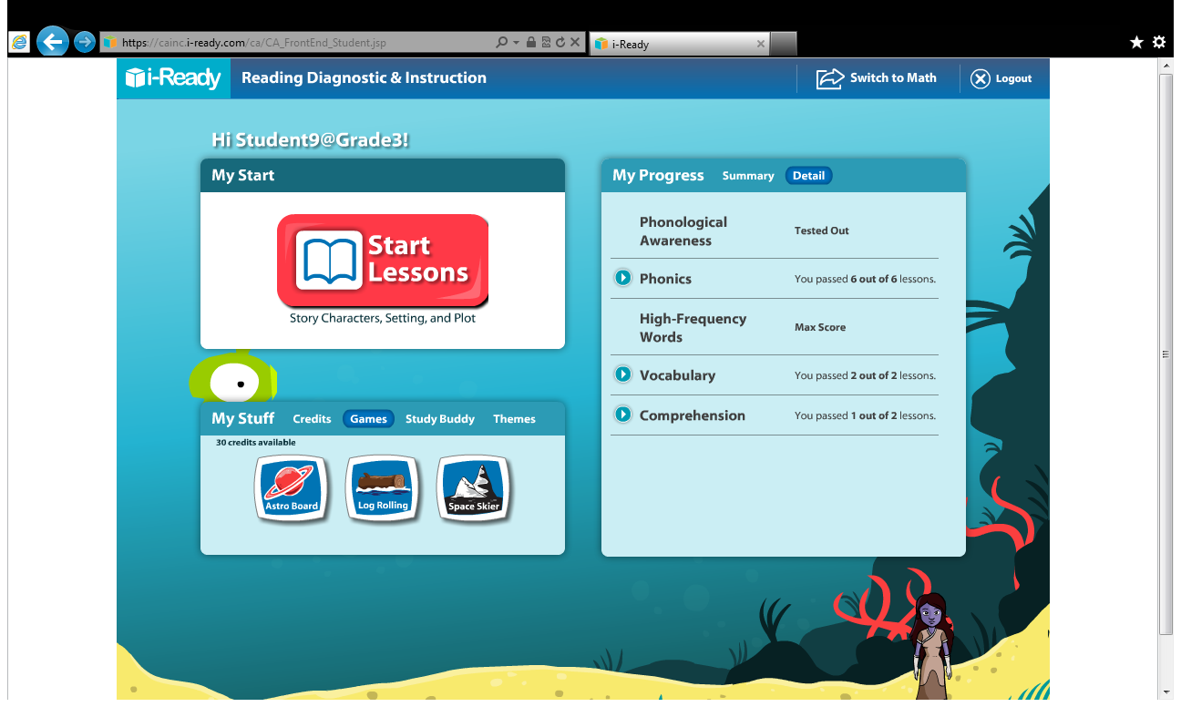
Student credits can be used to play fun games.

Slide 15
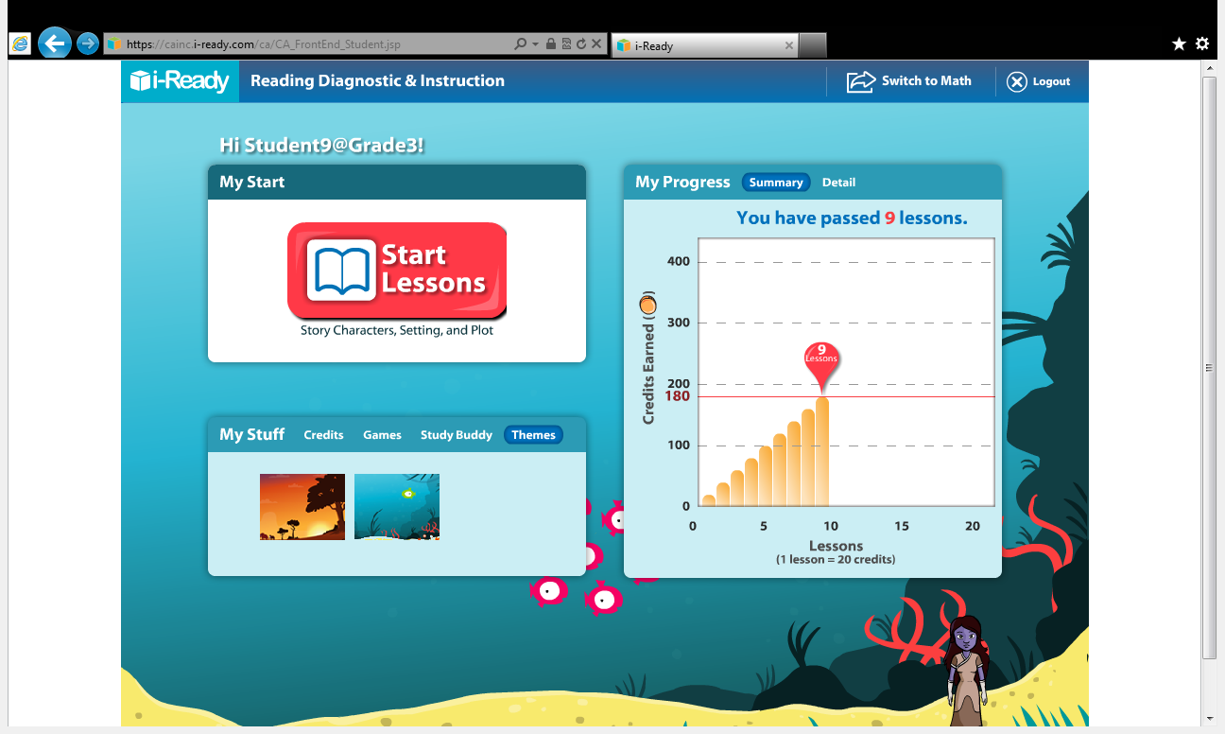
Don’t forget to click on “Logout” once your child is done for the day.

