Slide 1
In this unit, you will explore different types of waves and how they travel. You will learn how waves relate to energy and light. You will also explore the properties of light and how we perceive light
Unit 7: Waves, Sound, and Light

Slide 2
Lesson 1: Waves
In this lesson, you will learn how different types of waves transfer energy from one place to another. You will also explore the properties of waves and how these properties are measured.

Slide 3
Movement of Energy
Energy can travel from one place to another.
Remember that thermal energy can move from one object to another by heat flow, and that objects in motion can transfer energy.
Energy can also move from one place to another through waves.
Light, sound, and other forms of energy travel in waves.
Waves carry energy away from the energy source through space or through matter.
When a wave transfers energy, matter does not move with the energy.

Slide 4
Waves and Energy
A medium is any substance that a wave can travel through.
Sound waves often travel through the medium of air.
Waves that require a medium to travel are called mechanical waves

Slide 5
Transverse Waves
We can think of mechanical waves as a disturbance in the medium they travel through.
The energy of a mechanical wave causes the particles in the medium to vibrate as the wave passes through.
As the particles vibrate, they transfer energy to one another.
The way the particles move in relation to the movement of the wave creates different types of waves.
A transverse wave is a wave in which the particles in the medium move perpendicularly, or at a right angle to the direction of the wave.

Slide 6
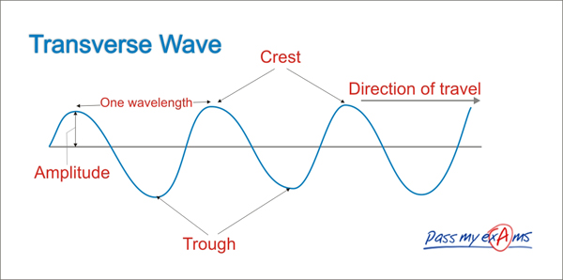

Slide 7
Longitudinal Waves
Mechanical waves can also cause the particles in a medium to move together or apart parallel to the direction of the wave.
Waves that are carried this way are called longitudinal waves. Sound waves travel in longitudinal waves.
These sound waves cause the particles in the air to vibrate back and forth in the same direction the wave travels.

Slide 8
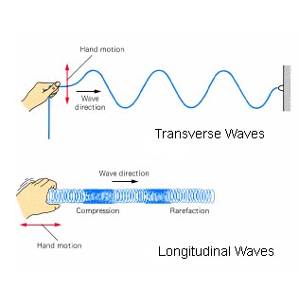

Slide 9
Surface Waves in Water
The waves on the surface of water move through the medium of water, so they are mechanical waves.
But, are they transverse or longitudinal waves?
The motion is actually both transverse and longitudinal. This type of wave is called a surface wave.
The next time you see a wave traveling across water, try to envision the water moving in circles rather than horizontally across the surface.

Slide 10
Properties of Waves—Amplitude
Amplitude is the height of a wave.
Scientifically, it is the measure of how far the back-and-forth motion of the wave occurs at each location.
The amplitude of the transverse wave is the height of the wave from this flat line.
The highest part of a wave is called the crest, and the lowest part of the wave is called the trough.
The amplitude of a wave is related to the energy it carries.
The higher the amplitude, the more energy the wave carries.
Loud sound waves have greater amplitude and carry more energy than soft ones.

Slide 11
Properties of Waves— Wavelength
Another property of a wave is its wavelength.
Wavelength is exactly what it sounds like–the distance between two consecutive crests or troughs.
Actually, the wavelength can be measured from a point on a wave to the next similar point, or the total length of one complete wave.
A wavelength’s size also relates to the wave’s frequency.

Slide 12
Properties of Waves—Period and Frequency
The period of a wave is the amount of time between one wave and the next (a wavelength) as it passes a specific location.
The period of a wave is related to the frequency of a wave.
The frequency is a measure of how many wavelengths pass a given point per second.
Frequency is expressed as cycles per second, or hertz (Hz).

Slide 13
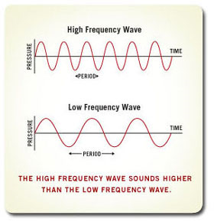

Slide 14
Lesson 2: Electromagnetic Waves
In this lesson, you will explore electromagnetic energy and some of its properties and applications in everyday life.

Slide 15
What Are Electromagnetic Waves?
a beam of light or a rainbow
the warmth of the sun on your skin
how a radio transmits sound
how an X-ray machine makes images of your teeth or bones
All of these transfer energy in a type of wave called an electromagnetic wave.

Slide 16
Similarities in Mechanical and Electromagnetic Waves
Sound and light both travel in waves
sound travels as mechanical waves
light travels as electromagnetic waves
both types of waves transfer energy
They both have the following properties:
• amplitude • wavelength • frequency

Slide 17
Differences Between Mechanical and Electromagnetic Waves
Recall that mechanical waves can only transfer energy through a substance called a medium.
Electromagnetic waves do not require a medium to transfer energy…transfer energy due to electric and magnetic fields.

Slide 18
Mechanical and Electromagnetic Waves—Differences in Speed
The speed of an electromagnetic wave slows as it travels through matter and as the density of matter increases.
Mechanical waves require the movement of particles in matter to transfer energy…how fast they travel depends on how dense the matter is and how well it springs back when part of it is compressed or slightly displaced.

Slide 19
The Speed of Light
Why do you see the lightning before you hear the thunder?
The answer lies in the speed of electromagnetic waves—the speed of light.
Electromagnetic waves travel at a speed of about 300,000 km/s (186,000 mi/s)—the speed of light.
Nothing else in the universe travels as fast
Electromagnetic waves of light travel thousands of times faster than the mechanical waves of sound in the same medium.
This is why you often see lightning in the sky before you hear the thunder clap

Slide 20
The Electromagnetic Spectrum
The energy transmitted by an electromagnetic wave is called radiant energy.
The frequency of an electromagnetic wave determines how much radiant energy the wave can carry.
Short wavelength electromagnetic waves have a higher frequency
Long wavelength electromagnetic waves have a lower frequency
The range of electromagnetic waves is called the electromagnetic spectrum.

Slide 21
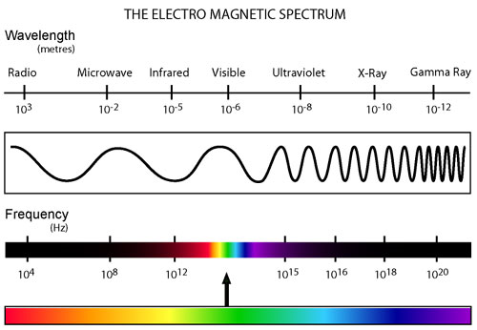

Slide 22
Lesson 3: Light Waves
In this lesson, you will explore the many properties of light and how they relate to the world around you.

Slide 23
Light Waves
Light travels outward in electromagnetic waves from sources such as the sun, a lamp, or a fire.
When light waves travel through a medium that is uniform, or unchanging, such as open air, they travel in straight lines…light waves travel in straight lines unless something, like a change in medium, disturbs their motion.
Light waves also travel in all directions from their source.

Slide 24
Light Waves and Matter—Transmission
When they contact matter, light waves can be affected in three ways, they can be:
Transmitted
Absorbed
Reflected
The passing of light through an object is called transmission.

Slide 25
Light Waves and Matter—Reflection
The property of light waves bouncing off matter is called reflection
Even when light is transmitted through objects, some light is always reflected.
The reason we can see objects around us is because our eyes detect the light the objects reflect.
When our eyes detect reflected light, they send a signal to the brain.

Slide 26
Light Waves and Matter—Absorption
Light waves that contact an object and do not bounce off its surface or pass through it are absorbed by the object.
Reflection and absorption of visible light waves determine the color of objects.
An object reflects some colors of light and absorbs other colors of light.
The color of an object is determined by the wavelength of light that an object reflects.
Our eyes interpret this wavelength as color

Slide 27
White Light
You may remember that visible light is a narrow range of wavelengths on the electromagnetic spectrum that human eyes can see.
Our eyes perceive the different wavelengths of visible light as colors in the visible spectrum.
The colors of the visible spectrum include red, orange, yellow, green, blue, indigo, and violet.
White light contains all of the colors of the visible spectrum.
the sun, a light bulb, and a candle are examples of white light

Slide 28
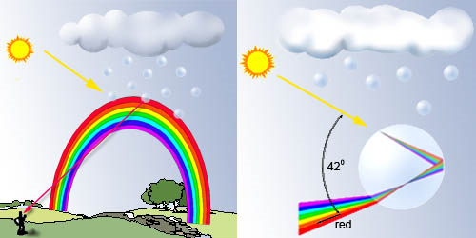
How a rainbow works

Slide 29
How Eyes Detect Light
How do our eyes detect different wavelengths of light?
The back of our eyes has a layer of cells called the retina.
This region contains many cells called photoreceptors.
The photoreceptors detect different wavelengths of light and send these signals to the brain.
Photoreceptors in the retina are light sensitive.
Color-sensitive photoreceptors are called cones.
Three types of cones respond to short, medium, and long wavelengths of light.
By combining information from all three types of cones, we see all the colors of the visible spectrum.

Slide 30
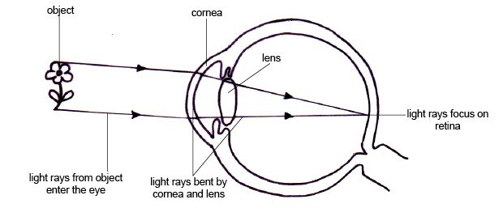
How eyes see light

Slide 31
How Plant Cells Interact with Light
Like the cells in the retinas of our eyes, some cells in plants also respond to different wavelengths of light.
They use light in a chemical reaction to make food.
Most plant leaves contain chlorophyll, a molecule that absorbs certain wavelengths of light.
Chlorophyll absorbs a lot of red and blue light, but not much green light.
Green light that is not absorbed is reflected.
The photoreceptors in our eyes detect this reflected light, and we see the leaves as green.

Slide 32
Lesson 6: Reflection and Refraction
In this lesson we’ll shed some light on these interactions so you can learn how we see what we see and find out how rainbows form.

Slide 34
Reflection and Refraction
You see things because of light coming from them.
You see a spoon because light "bounces" off the spoon and enters your eye, which sends a message to your brain.
Light bouncing off something is called reflection.
When light is reflected, the direction of its path changes.
The change of direction when light passes from one medium into another is called refraction.

Slide 35
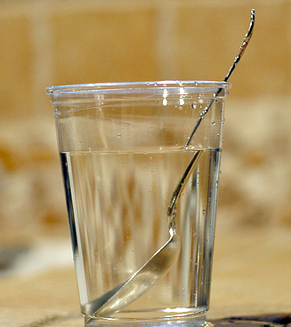
Light Rays
When light travels through a uniform medium, such as air, it does not change direction.
When a beam of light crosses a dark room, dust particles in the air show the path of light, and it is always a straight path.

Slide 36
Reflecting, Absorbing, and Transmitting Light
Reflection: when light bounces off of an object, such as a mirror or the surface of the water
Transmission: when light passes through an object, such as a window
Absorption: when light strikes an object, such as a wall, and is not transmitted or reflected
***Typically, light is not solely reflected, or transmitted, or absorbed. Instead, it often does all three to varying degrees.

Slide 37
How Refraction Works
When light moves from one transparent medium to another, it often changes speed.
The change of speed causes the light to change direction, and this change of direction is called refraction.
That’s why a straw in a glass of water looks bent from some angles, even though it’s really straight.
The light bends because it changes speed from one medium to the other.
Light has different speeds in different materials.

Slide 40
Composition of a Medium and Speed of Light
You may remember that the speed of light is constant in a vacuum.
Usually, though, light is not traveling in a vacuum.
Two exceptions are in light bulbs, which feature a partial vacuum, and in outer space, which is also considered a vacuum.
When light is not traveling in a vacuum, it is being transmitted through a medium.
As it moves, its speed changes, and the amount of this change depends on the composition of the medium.
When light travels through air, it moves just slightly slower than it does in a vacuum.
In water, light moves about 25% slower than in a vacuum.
Light travels about 33% slower through glass than in a vacuum
K12 EX. Rainbow

Slide 41
Light is Everywhere!
Unless you happen to be standing in a dark closet, the chances are very good that you are surrounded by light.
Some of this light is reflecting off surfaces, some is absorbed, and still more light may be transmitted through mediums.
Different materials respond differently to light

Slide 42
Lesson 7: Lenses
In this lesson, you will explore what lenses are, how they work, how they are used in instruments, and how they help us see.

Slide 43
Lenses
What exactly is a lens?
A lens is a transparent object with at least one curved surface.
Because of the curve of a lens, light strikes most parts of it at an angle.
Like the beam of light entering water in the previous example, light that strikes a lens at an angle refracts.
Light that does not strike a lens at an angle continues through the lens without changing directions.
The greater the curve of the lens, the more the light will bend as it passes through it.

Slide 44
Types of Lenses
2 types of lenses are concave lenses and convex lenses.
They differ in how they are curved and how they refract light.
Concave lens are thicker at the edge than in the middle.
curve inward.
Remember concave with caved in.
cause the light rays passing through them to spread apart.
Convex lens are thicker in the middle than at the edge.
curve outward
cause the light rays passing through them to come together.

Slide 46
Concave Lenses
Light rays that pass through the curved edges of the concave lens strike the lens at an angle and bend outward, spreading apart.
Light rays that pass through the exact center of the lens are perpendicular to the surface and continue in a straight line.
Because light is refracted in this way, looking at something through a concave lens makes it appear smaller than it actually is.

Slide 47
Convex Lenses
In this lens, light rays that pass through the curved edges bend inward, they come together.
As in concave lenses, light that passes through the exact center of a convex lens continues in a straight line.
looking at something through a convex lens makes it appear larger than it really is

Slide 48
Devices with Lenses
Many devices use lenses, such as binoculars, telescopes, microscopes, and cameras.
These instruments all have convex lenses.
Many of these instruments, such as the binoculars, have more than one lens, and may also have prisms and flat or curved mirrors to make small objects appear even larger

Slide 49
The Human Eye has a Lens
The lens we use most often is the one in the human eye.
A small convex lens sits near the front of the eye.
The transparent, front part of the eye, called the cornea, is also curved.
When light rays reflected off an object pass into the eye, the cornea and then the lens bend the light rays toward each other.
The light rays come together and strike the light-sensitive cells in the retina at a single spot.
These cells then send signals to the brain.
The brain interprets these signals as an image.

Slide 50
Stay Focused with Corrective Lenses
How does the human eye focus so that we can see objects at different distances clearly?
We have small muscles in our eyes that change the shape of the lens to focus the light from an object in a single spot on the retina.
Sometimes people’s eyes lose this ability to focus.
People who cannot focus on close-up objects are farsighted. In these people’s eyes, light rays from objects converge at a point beyond the retina.
People who cannot focus on distant objects are nearsighted. In these people’s eyes, light rays from objects converge at a point before the retina.

Slide 51
Lenses in Your Life
The ability of light to be refracted through a lens is very important.
The convex lens in our eyes help us see by bringing light rays together in one spot on the retina.
This principle of bending light through a lens is applied to devices such as binoculars, telescopes, microscopes, and cameras

